Slide 1
MalGanga Cafe
Food Ordering System
A full-stack web application for restaurant order management
Built with Python Flask | SQLite | HTML/CSS
Names of team members:- 1.shelke Krushna
2.Abhishek shinde
3. Jayesh shirshat
4. Harshad sapkal
Slide 1 of 10

Slide 2
Project Overview
What is it?
A web-based food ordering system for a restaurant/cafe named MalGanga Cafe.
Purpose
Digitise the order process — from browsing the menu to generating a GST bill.
Users
Two roles: Customers (browse, order) and Admin (monitor, manage orders).
Technology
Python Flask backend, SQLite database, Jinja2 templates, plain HTML/CSS frontend.
Deployment
Runs locally via Flask dev server; database auto-initialised on first launch.
Slide 2 of 10

Slide 3
Technology Stack
🐍
🌶️
🗄️
Python 3
Flask
SQLite
Core backend language
Lightweight web framework
Embedded relational database
🎨
🧩
��
HTML / CSS
Jinja2
Flask Session
Frontend UI & styling
Server-side templating engine
Cookie-based cart sessions
Slide 3 of 10

Slide 4
Database Schema (SQLite)
categories
menu_items
orders
order_items
cart_items
id
id
id
id
id
name
category_id
customer_name
order_id
session_id
icon
name
customer_phone
menu_item_id
menu_item_id
description
table_number
quantity
quantity
price
order_type
unit_price
is_available
status
subtotal
total_amount
created_at
Relationships: menu_items -> categories | order_items -> orders & menu_items | cart_items -> menu_items
Slide 4 of 10

Slide 5
Application Routes & Endpoints
GET
/
Home page with hero section & category links
GET
/menu
Menu listing with category filter & search
POST
/cart/add/<item_id>
Add item to session-based cart
POST
/cart/remove/<id>
Remove item from cart
POST
/cart/update/<id>
Update item quantity (0 = auto-remove)
GET
/cart
View cart with subtotal, GST & grand total
POST
/checkout
Place order, save to DB, clear cart
GET
/bill/<order_id>
View printable GST invoice for an order
GET
/admin
Admin dashboard — stats & all orders
POST
/admin/status/<id>
Update order status (pending/preparing/ready/completed/cancelled)
Slide 5 of 10

Slide 6
Key Features
🍽️ Menu Browsing
🛒 Smart Cart
Filter by 5 categories (Starters, Main Course, Breads, Beverages, Desserts) and search by name.
Session-based cart persists across pages. Quantity +/- controls, auto-remove on zero.
🧾 GST Billing
📦 Order Types
Auto-calculates 5% GST (CGST 2.5% + SGST 2.5%) and generates a printable invoice.
Supports Dine-In (with table number) and Takeaway orders.
📊 Admin Dashboard
🔄 Order Status Flow
Real-time stats: total orders, revenue, pending & completed counts. Search by customer name.
Admin can move orders through: Pending → Preparing → Ready → Completed / Cancelled.
Slide 6 of 10

Slide 7
Customer Order Flow
1
→
2
→
3
→
4
→
5
→
6
Home Page
Browse Menu
Add to Cart
Review Cart
Checkout
Bill / Invoice
Land on hero page, see categories
Filter by category or search by name
Click + Add; badge shows count
Adjust qty, see GST & grand total
Enter name, phone, order type & table
Printable GST bill generated instantly
Slide 7 of 10

Slide 8
Admin Dashboard
📋 Total Orders
💰 Total Revenue
⏳ Pending
✅ Completed
All orders placed
Excl. cancelled
Awaiting action
Fulfilled orders
Orders Table
Order #
Customer
Phone
Type
Table
Amount
Date/Time
Status
Update
Bill
#0001
Rahul S.
9876543210
Dine-In
5
₹520
2024-01-15 13:22
Completed
—
🧾
#0002
Priya M.
9123456780
Takeaway
—
₹340
2024-01-15 14:05
Pending
▼
🧾
Status options: Pending | Preparing | Ready | Completed | Cancelled
Slide 8 of 10

Slide 9
GST Invoice Generation
🍛 SpiceCraft
Auto-Calculation
GST computed as 5% of subtotal, split equally into CGST & SGST.
123 Gourmet Lane, Maharashtra
GSTIN: 27AABCS1429B1ZB
Invoice Fields
Invoice No., Date, Time, Customer, Phone, Order Type, Table No.
━━━━━━━━━━━━━━━━━━━━━━
Invoice #0001 | 15-Jan-2024
Customer: Rahul S. | Dine-In Table 5
Item Breakdown
Each item listed with quantity, unit rate and line subtotal.
━━━━━━━━━━━━━━━━━━━━━━
Butter Chicken x2 ₹560
Garlic Naan x3 ₹150
Print Support
Browser print dialog triggered; print-specific CSS hides nav/buttons.
Mango Lassi x1 ₹100
━━━━━━━━━━━━━━━━━━━━━━
Compliance
GSTIN and FSSAI licence number displayed on every invoice.
Subtotal: ₹810
CGST 2.5%: ₹20
SGST 2.5%: ₹20
GRAND TOTAL: ₹851
Slide 9 of 10

Slide 10
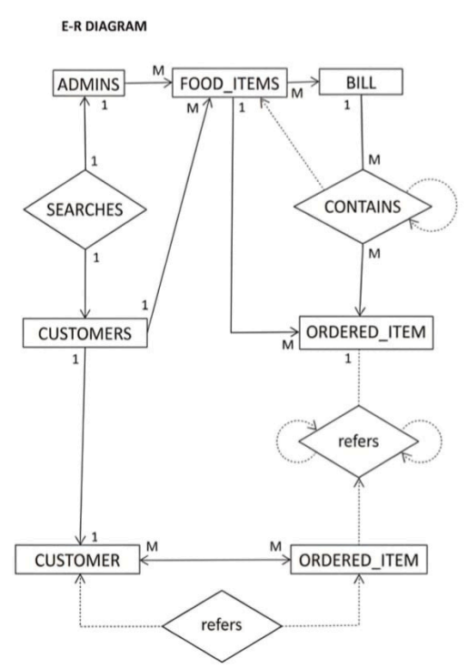

Slide 11
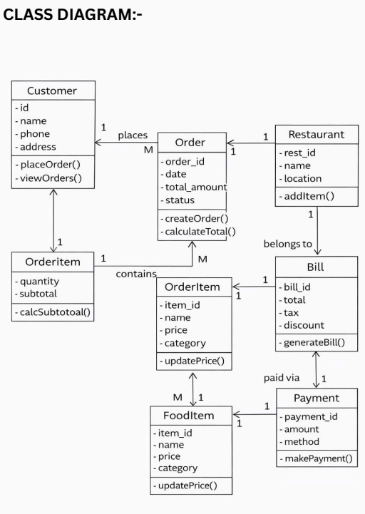

Slide 12
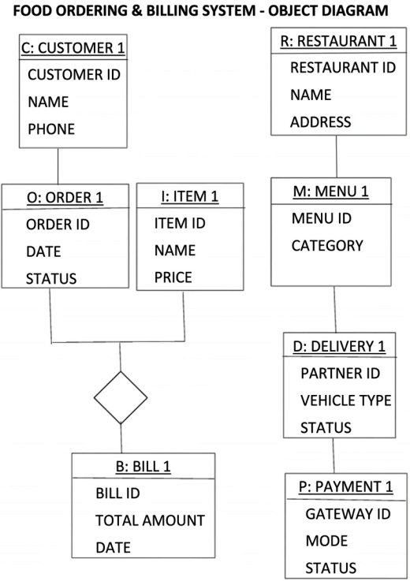

Slide 13
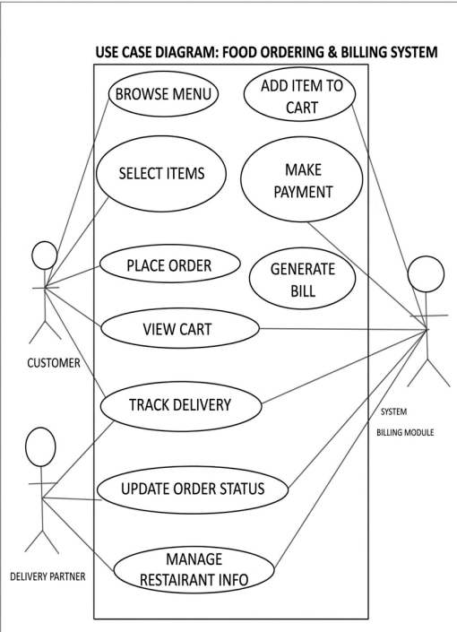

Slide 14
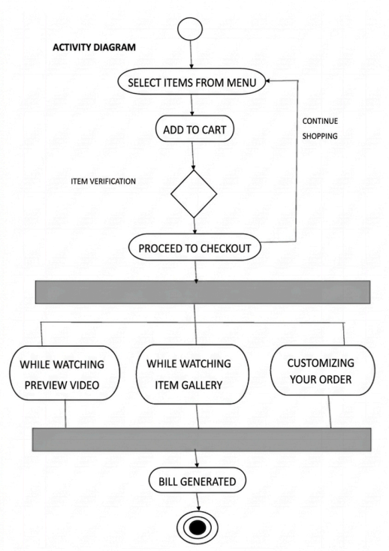

Slide 15
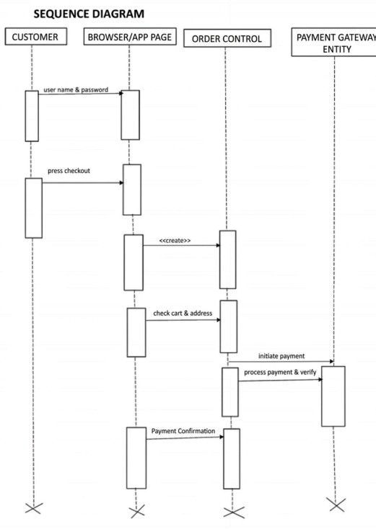

Slide 16
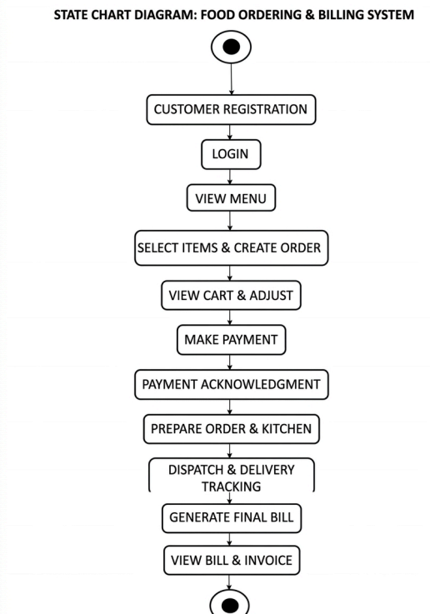

Slide 17
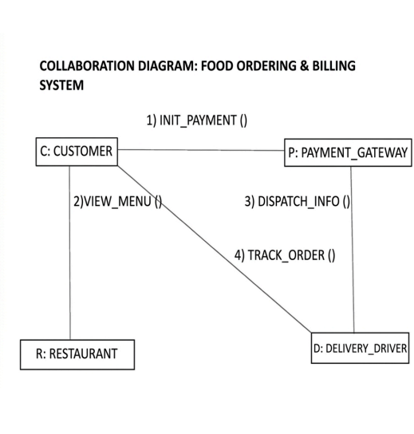

Slide 18
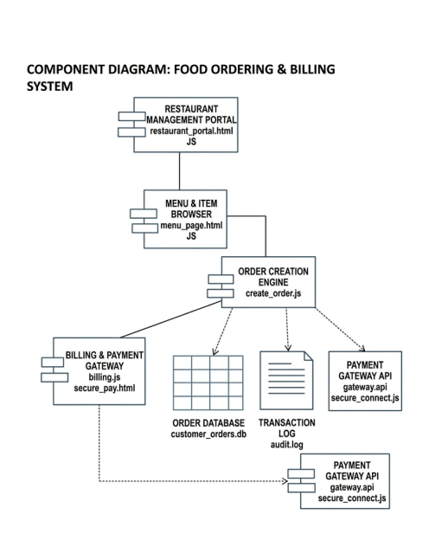

Slide 19
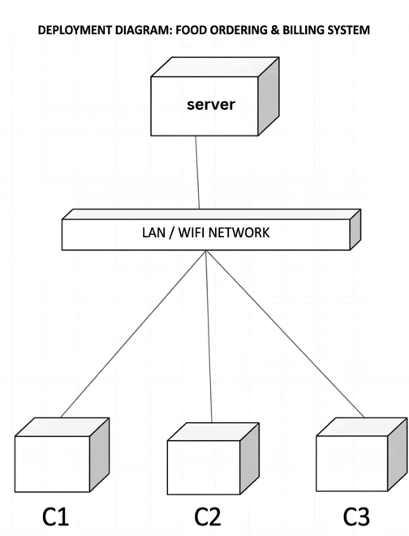

Slide 20
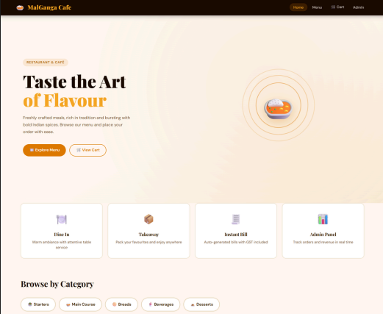

Slide 21
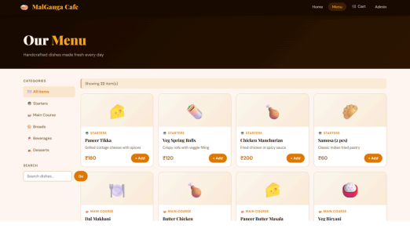

Slide 22
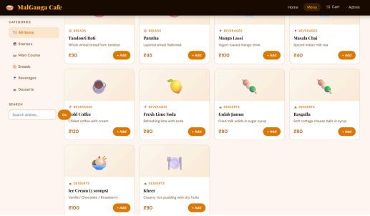

Slide 23
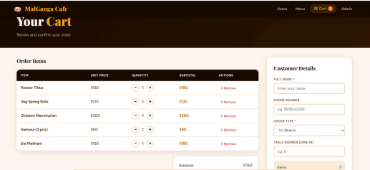

Slide 24
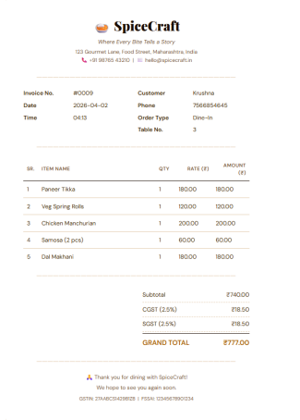

Slide 25
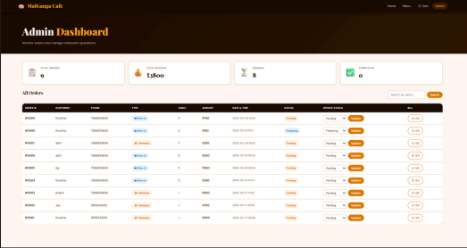

Slide 26
Conclusion
✅
Complete Order Lifecycle
From menu browsing to GST invoice — the entire workflow is covered end-to-end.
✅
Lightweight & Fast
Flask + SQLite stack requires zero external services; runs on any machine instantly.
✅
Real-Time Admin Control
Admins can track revenue, monitor order status and search customers live.
✅
Scalable Foundation
Easy to extend with user auth, online payments, delivery tracking, or a REST API.
✅
Clean UI/UX
Responsive design with category filters, cart badges, and print-ready invoices.
MalGanga Cafe Food Ordering System — Built with Python Flask, SQLite & HTML/CSS

